Slide 1
Flow of Control
Flow of control is the order in which statements are executed.
In the programs that we have written so far, our code has been executed one line at a time in the order that it was written.
This order is called linear - meaning that programs are executed one statement at a time, one after another.

Slide 2
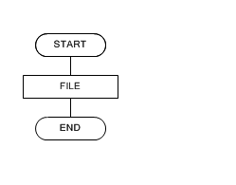
pseudocode

Slide 3
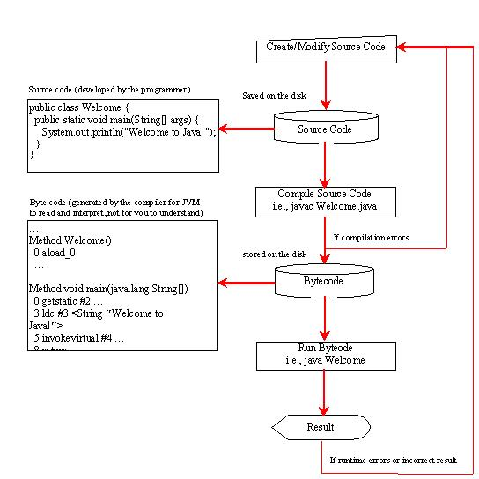

Slide 4
Conditional / Selection Statement
Conditional or selection statements allow us to choose which statement of code will be executed next.
This is helpful if you want to repeat a statement of code or if you want to skip it altogether.
To do this, in Java, we use if statements, if-else statements, and switch statements.

Slide 5
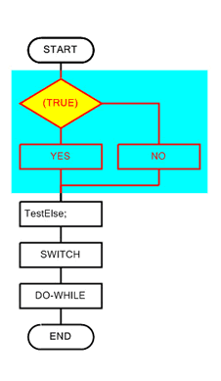

Slide 6
Decision Making
we can repeat or skip lines of code we need to make the decision when to do that.
This is done with boolean expressions.
It is possible to write code that will allow us to use a boolean expression to make a decision on whether or not a statement should be executed.
Boolean expressions will either be evaluated true or false.
If the expression is true, then the code should be executed.
If it is false, then the code would be skipped over.

Slide 7
Relationship Operators
When using a boolean expression we will need to compare it to some value in order to test if it is true or false. The following is a list of relationship operators that can be used:
== Equal to
!= Not equal to
> Greater than
>= Greater than or equal to
< Less than
<= Less than or equal to

Slide 8
Flow of Control
There are times when we may want one block of code to be executed several times instead of just once.
For example, in our assignment2 Foo Corporation employee payment,
How would you write code that would do multiple employee payment?

Slide 9
method
A method is a set of code which is referred to by name and can be called (invoked) at any point in a program simply by utilizing the method's name.
Think of a method as a subprogram that acts on data and often returns a value.
Each method has its own name.

Slide 10
In the Java programming language, a method signature is the method name and the number and type of its parameters. Return types and thrown exceptions are not considered to be a part of the method signature.

Slide 11
Defining Methods
Here is an example of a typical method declaration:
public double calculateAnswer(double wingSpan, int numberOfEngines, double length, double grossTons)
{
//do the calculation here
}

Slide 12
The only required elements of a method declaration are:
the method's return type
name
a pair of parentheses ()
and a body between braces {}

Slide 13
More generally, method declarations have six components, in order:
Modifiers—such as public, private, and others you will learn about later.
The return type—the data type of the value returned by the method, or void if the method does not return a value.
The method name—the rules for field names apply to method names as well, but the convention is a little different.
The parameter list in parenthesis—a comma-delimited list of input parameters, preceded by their data types, enclosed by parentheses, (). If there are no parameters, you must use empty parentheses.
An exception list—to be discussed later.
The method body, enclosed between braces—the method's code, including the declaration of local variables, goes here.
nents, in order:

Slide 14
Modifiers, return types, and parameters will be discussed later in this lesson. Exceptions are discussed in a later lesson.

Slide 15
The signature of the method declared above is:
calculateAnswer(double, int, double, double)
Two of the components of a method declaration comprise the method signature—the method's name and the parameter types.

Slide 16
Naming a Method
Although a method name can be any legal identifier, code conventions restrict method names.
By convention, method names should be a verb in lowercase or a multi-word name that begins with a verb in lowercase, followed by adjectives, nouns, etc.
In multi-word names, the first letter of each of the second and following words should be capitalized. Here are some examples:
run
runFast
getBackground
getFinalData
compareTo setX
sEmpty

Slide 17
The origin of the Java language began in 1991 when Sun Microsystems' lead architect James Gosling, along with coworkers Mike Sheridan and Patrick Naughton, designed it for use in interactive television

Slide 18
Exercise
Write a program the takes the radius of a sphere as input and output the sphere’s diameter, circumference, surface area, and volume.

